Slide 1


2023-24-133
MOODMate
EMOTION RECOGNITION AND SENTIMENT ANALYSIS FOR RELATIONSHIP IMPROVEMENT
TMP-2023-24-133
Sri Lanka Institute of Information Technology

Slide 2







MEET OUR TEAM
Ms. Thilini Jayalath
Miss. Shalindi
Pandithakoralage
Dr. Dilshan De Silva
Supervisor
Co-Supervisor
External Supervisor
A.I Bataduwaarachchi
H.G.C.Dilini
N.K.A.S.Dilshan
K.P.D.Thimesha
IT20647414
IT20651442
IT20648886
IT20648268

Slide 3


OVERALL PROJECT INTRODUCTION
Relationship breakdown is a prevalent issue globally .
According to the WHO, around 280 million people worldwide suffer from depression.
The high incidence of severe emotional distress.
Our research aims to address these challenges by introducing a emotion recognition and sentiment analysis for relationship improvment.

Slide 4
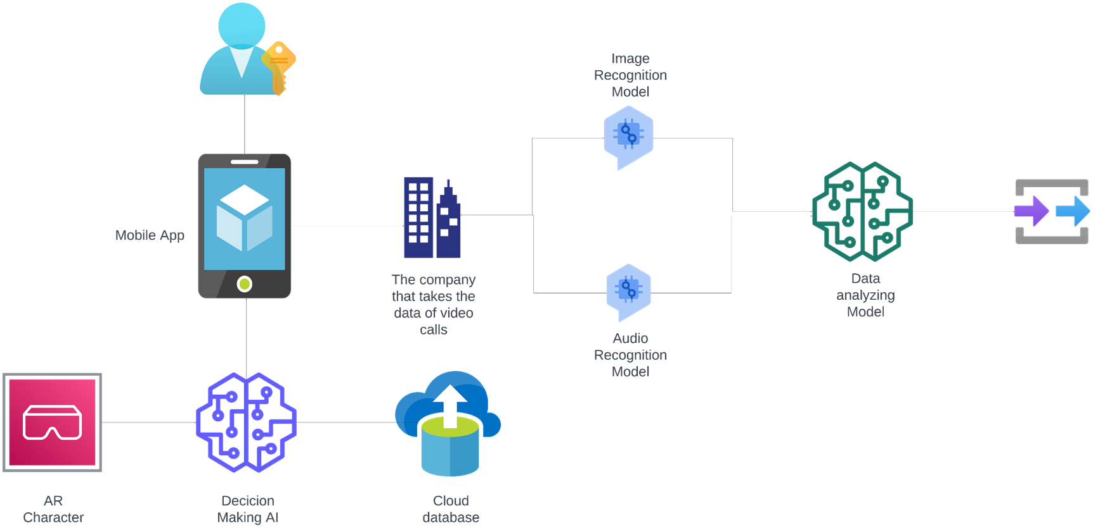
METHODOLOGY
System Diagram

Slide 5

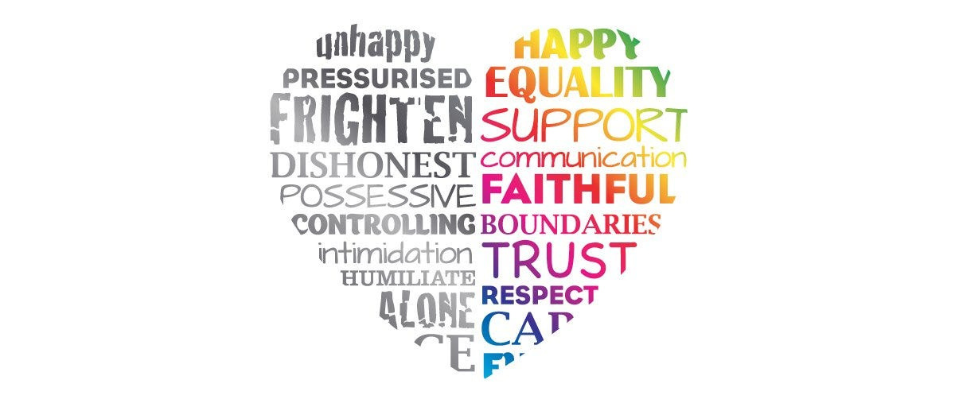

IT20647414 | Bataduwaaracchchi
Specialization - Information Technology
IT20647414 | BATADUWAARACHCHI A.I
2023-24-133 | 10/03/2023

Slide 6

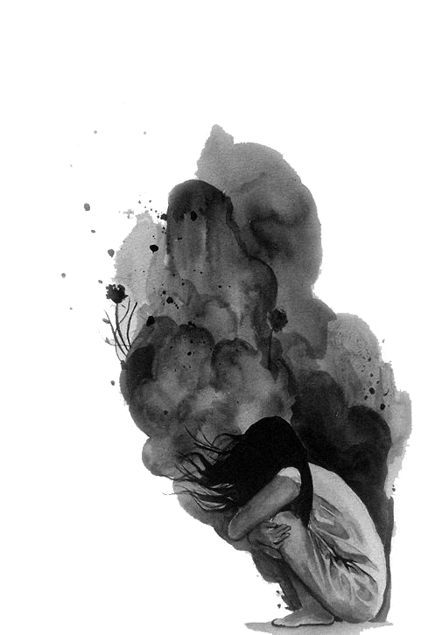
Introduction
Humans maintain relationships with
each other socially for survival and
reproduction.
Only 13% of people maintain the good
Mental Health in Relationship
The quality of human relationships is directly important
for individual well-being and social harmony
We Provide newly solution with modern Technology to improve
human relationship and Mental health.
IT20647414 | BATADUWAARACHCHI A.I
2023-24-133 | 10/03/2023

Slide 7




Research Question
Social Experiences
How to provide social experiences for introverts and
people who fear relationships ?
Emotions
How to deal with Emotions and Mental Helath?
Relationship
How to start and maintain the good relationship?
IT20647414 | BATADUWAARACHCHI A.I
2023-24-133 | 10/03/2023

Slide 8






Specific and Sub Objective
Identifying the user's need.
AI Enhance VR environment
for Mental Health & Relationship
Build a Realistic VR environment
Build a user interacted Character with special backstory
Connected to the OpenAI and Other API to Unity Engine
IT20647414 | BATADUWAARACHCHI A.I
2023-24-133 | 10/03/2023

Slide 9
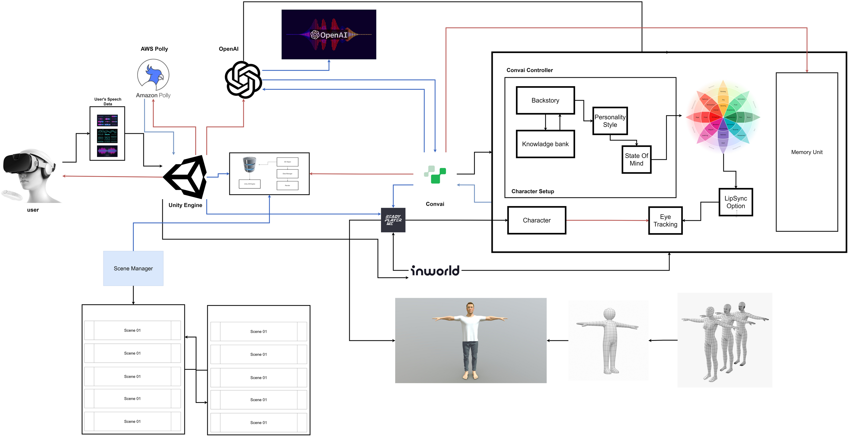
Methodology
System Diagram
IT20647414 | BATADUWAARACHCHI A.I
2023-24-133 | 10/03/2023

Slide 10




Methodology
Evidence of Completion
Data Collection and Backstory Creations
OpenAI, AWS polly and 3rd party API testing and integration
Build the runtime and Environment
Display the results in Unity Runtime
IT20647414 | BATADUWAARACHCHI A.I
2023-24-133 | 10/03/2023

Slide 11
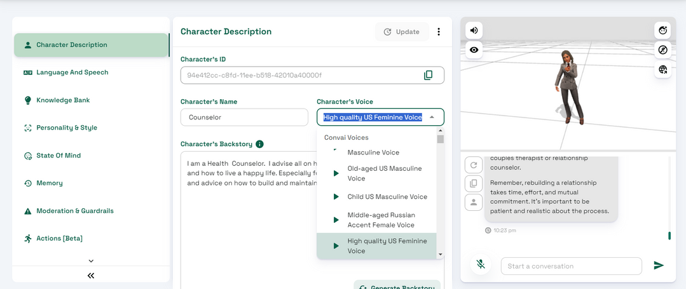
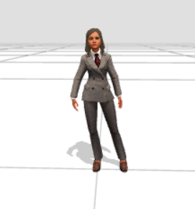
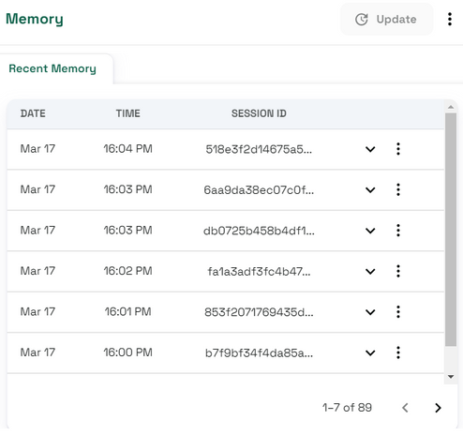
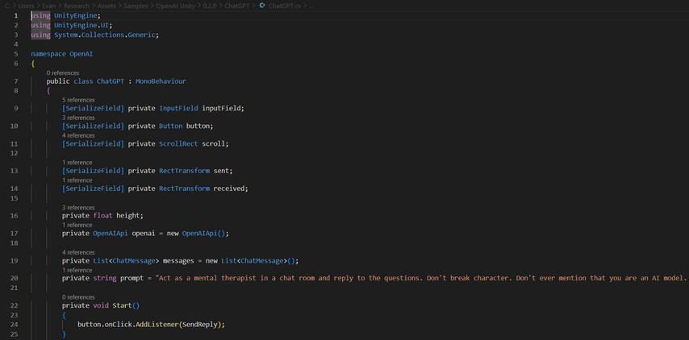
Methodology
Data Collection and Backstory Creations
IT20647414 | BATADUWAARACHCHI A.I
2023-24-133 | 10/03/2023

Slide 12

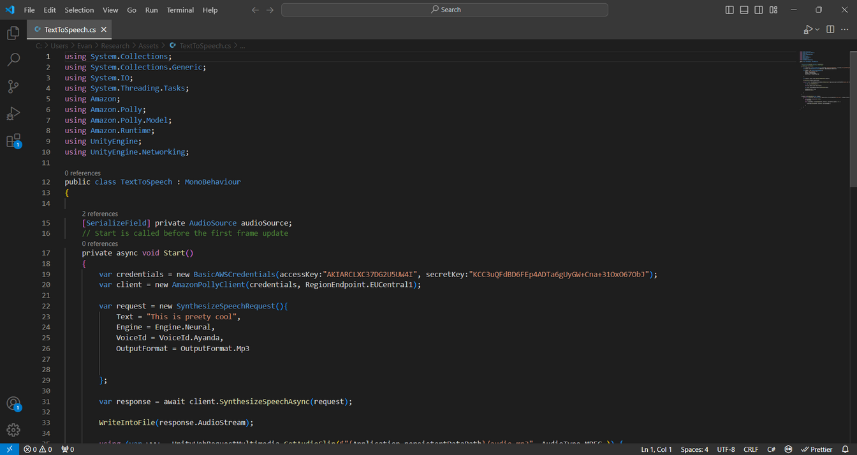
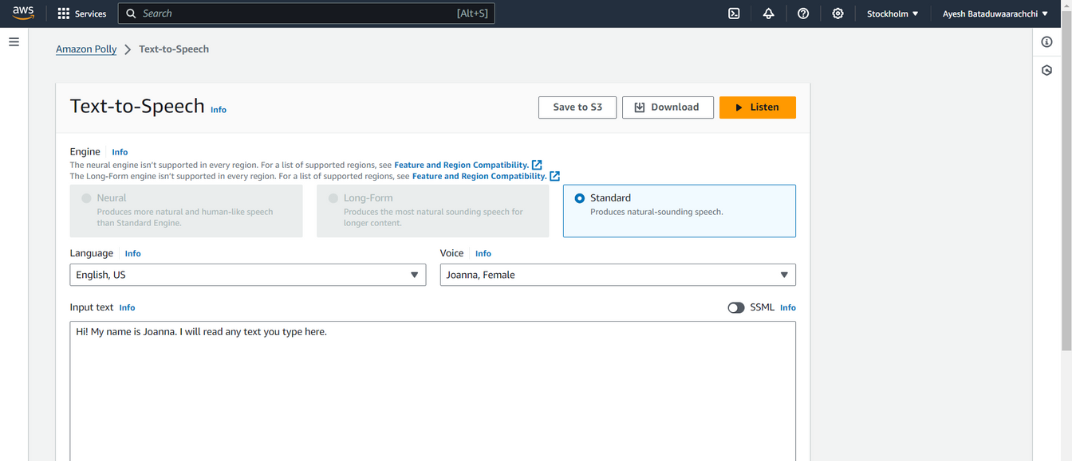
Methodology
OpenAI, AWS polly and 3rd party
API integration
Amazon polly
openAI Connection
IT20647414 | BATADUWAARACHCHI A.I
2023-24-133 | 10/03/2023

Slide 13


Methodology
Select the best model for conversation
generation
Why not Rasa framework
OpenAI
Runtime latency
Limitation of the answering
Time Consuming
Low accuracy
very less runtime latency
More accurate answers
generate
IT20647414 | BATADUWAARACHCHI A.I
2023-24-133 | 10/03/2023

Slide 14
Methodology
Select the VR environment
Why not AR Environment
VR
Poor Connection with user
Limited Capabilities
Low Attraction
Can provide high realistic
experience
More user engagement
Can provide Real-life
Experience
IT20647414 | BATADUWAARACHCHI A.I
2023-24-133 | 10/03/2023

Slide 15
Why Choose BERT for Conversation
Analyze?
Contextual Understanding: Leverages deep bidirectional training, understanding the context of words from both left and right sides.
State-of-the-art Architecture: Employs Transformer models, renowned for handling long-range dependencies in text.
Pre-training on Diverse Corpus: Trained on a vast corpus of the internet text, enabling it to understand a wide array of topics.
High Accuracy: Demonstrates superior performance on numerous NLP benchmarks, making it highly reliable for generating accurate responses.
IT20647414 | BATADUWAARACHCHI A.I
2023-24-133 | 10/03/2023

Slide 16






Methodology
Completion and Future Work
Completion of the components
Connected to the OpenAI and Other APIs to Unity
Build a Realistic VR environment
Build a user interacted Character with special backstory and test
Scale up the environment
Scale up the character knowledge.
IT20647414 | BATADUWAARACHCHI A.I
2023-24-133 | 10/03/2023

Slide 17


Methodology
Technologies, Techniques, Algorithms
Technologies
Algorithms
AWS polly
C#
.NET
Unity Plugin
Speech to text model
Text to speech model
LLM
IT20647414 | BATADUWAARACHCHI A.I
2023-24-133 | 10/03/2023

Slide 18


System, Personnel, and Software
Specification Requirements
Methodology
Functional Requirements
Non -Functional Requirements
Character response need to be accurate
Character play the role base on the backstory
Response should be relevant the scene
Should be low latency
User friendly character
Should work with all VR headset
More Accuracy on the environment
IT20647414 | BATADUWAARACHCHI A.I
2023-24-133 | 10/03/2023

Slide 19


System, Personnel, and Software
Specification Requirements
Methodology
Software Requirement
Personnel Requirements
Unity
Convai
inworldAI
ReadyPlayerMe
Visual studio
Shalindi Pandithakoralage (Licensed Clinical Psychologist)
IT20647414 | BATADUWAARACHCHI A.I
2023-24-133 | 10/03/2023

Slide 20
References
S. Holt, “Virtual reality, augmented reality and mixed reality: For astronaut mental health; and space tourism, education and outreach,” Acta Astronautica, Dec. 2022, doi:
[2]
K.-Y. Wang, A. R. Ashraf, Narongsak Tek Thongpapanl, and O. Nguyen, “Influence of social augmented reality app usage on customer relationships and continuance intention: The role of shared social experience,” vol. 166, pp. 114092–114092, Nov. 2023, doi:
[3]
H. Kumar and A. Martin, “Artificial Emotional Intelligence: Conventional and Deep learning Approach,” Expert Systems with Applications, p. 118651, Aug. 2022, doi:
[4]
A. J. Horn and C. S. Carter, “Love and longevity: A Social Dependency Hypothesis,” Comprehensive Psychoneuroendocrinology, vol. 8, p. 100088, Nov. 2021, doi:
IT20647414 | BATADUWAARACHCHI A.I
2023-24-133 | 10/03/2023

Slide 21
RECOGNIZE AN EMOTION USING IMAGE PROCESSING
IT20651442
DILINI
Gamage
INFORMATION TECHNOLOGY

Slide 22




Introduction
Research Question
How to identify user emotion using image processing?
Emotions are complex and can change over time. Therefore, we collect the number of blinks, body movements and behavior of the relevant person in relation to the relevant frames.

Slide 23
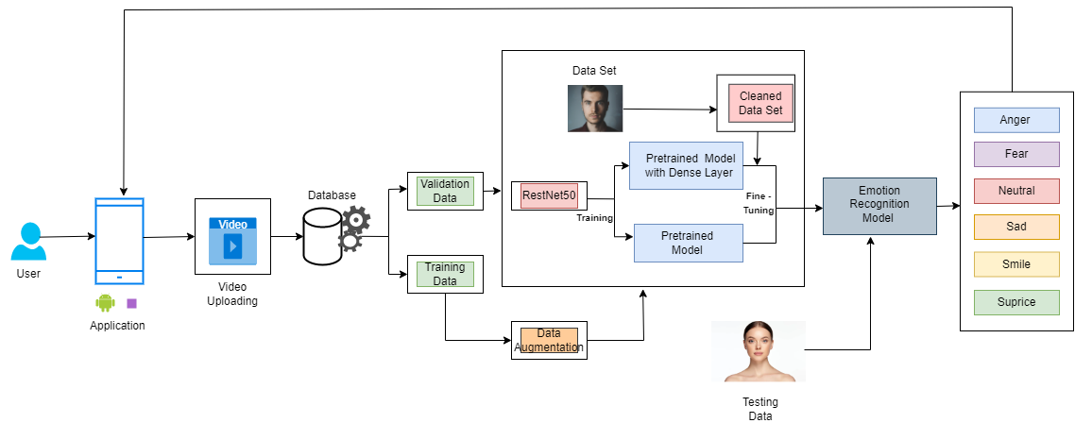
Methodology
System Diagram

Slide 24





Introduction
Specific and Sub Objectives
Gather video call feed
Identifying emotions using image processing
Develop Emotion Recognition Model.
Get Emotion Prediction From Video Data
Goal Tracking and Emotional Growth

Slide 25
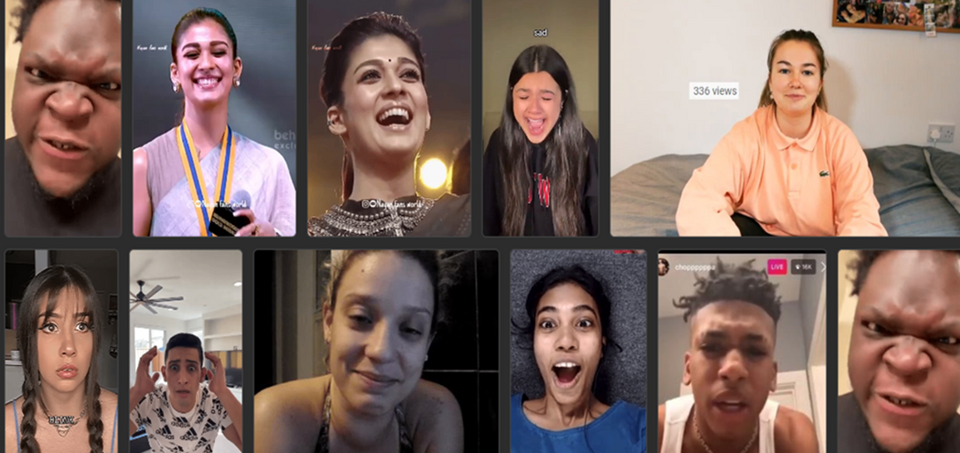
Sub Objective
Gather video call feed and image frames
All images 1818
Training set 1273 images
Validation set 545 images
Image data collect from video and councilor.
Data was collected and verified from the councilor.

Slide 26
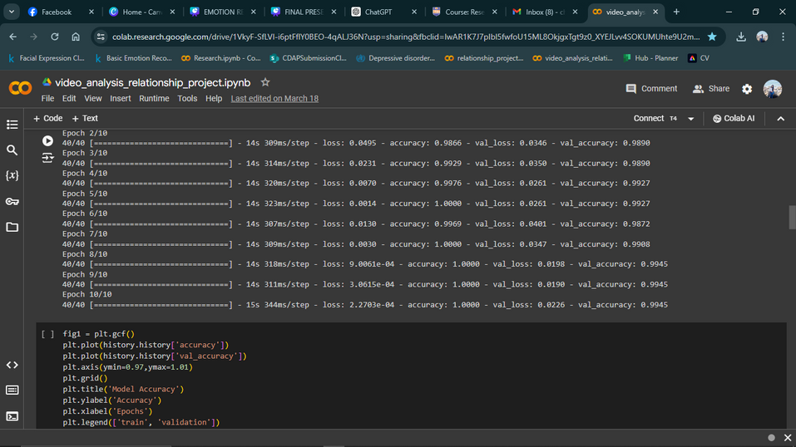
Sub Objective
Develop and Train Emotion Recognition Model
Identification of best architectures for emotion identification
Architeccture
Emotion Identification accuracy
VGGNet19
58.01%
VGGNet16
69.21%
RestNet50
99.45%

Slide 27

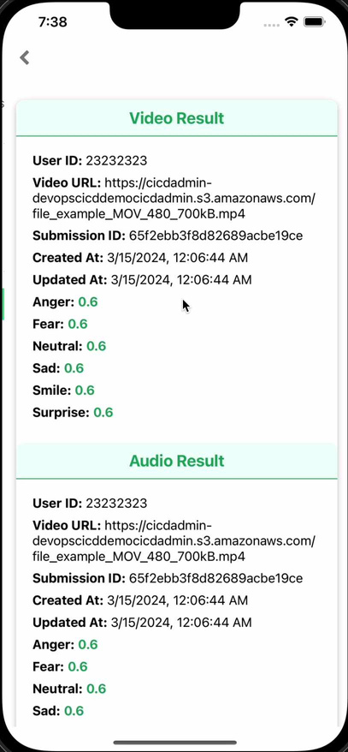
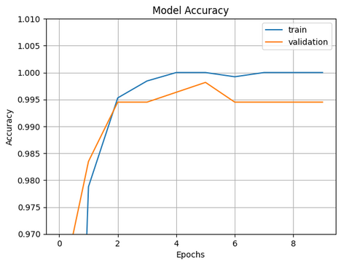
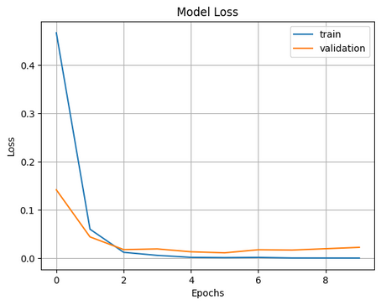
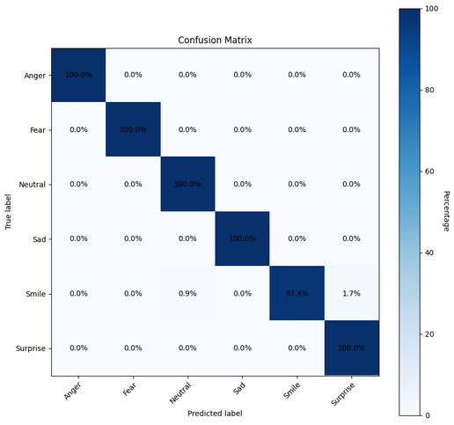
Sub Objective
Get Emotion Prediction From Video Data
Emotion Identification from Video Analysis Data.

Slide 28
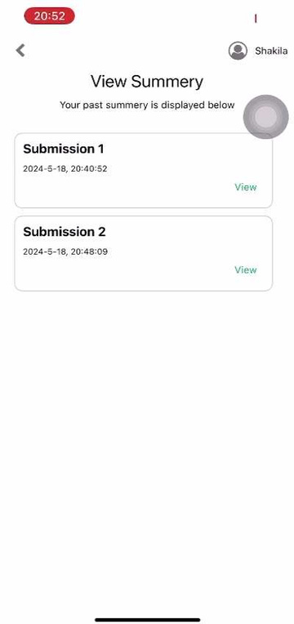
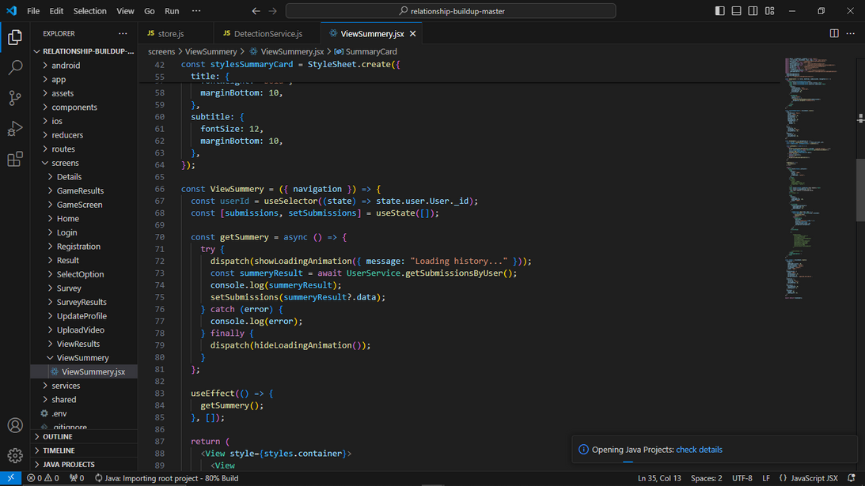
Sub Objective
Goal Tracking and Emotional Growth
View summary of Previous Emotions
user can access their previous emotion summary and get an about idea.

Slide 29

Completion
100%
Summary of Sub Objective Achievement
Implement system to gather video call feed
Train that model using dataset
Develop Emotion Recognition Model.
Goal Tracking and Emotional Growth Platform

Slide 30
AI-ENHANCED AUDIO BASED EMOTION RECOGNITION
IT20648268
DAMIDU
Thimesha
CYBER SECURITY

Slide 31


INTRODUCTION
RESEARCH QUESTION
How to identify user emotion from audio data input?
Emotions, from happy to fear, color our experiences and guide our actions. Speech data, like pitch and pace, can offer clues about a speaker's emotions. CNNs can be used for speech emotion recognition by taking spectrograms (visual representations of audio) as input. The CNN extracts features from the spectrogram that correlate with emotions like anger or sadness.
IT20648268 | Damidu Thimesha | TMP-2023-24-133

Slide 32

INTRODUCTION
SPECIFIC AND SUB OBJECTIVES
Extract audio data from video call feed
Identifying emotions using audio data
Develop deep learning emotion recognition model.
Train that model using dataset
Goal tracking and emotional growth
IT20648268 | Damidu Thimesha | TMP-2023-24-133

Slide 33
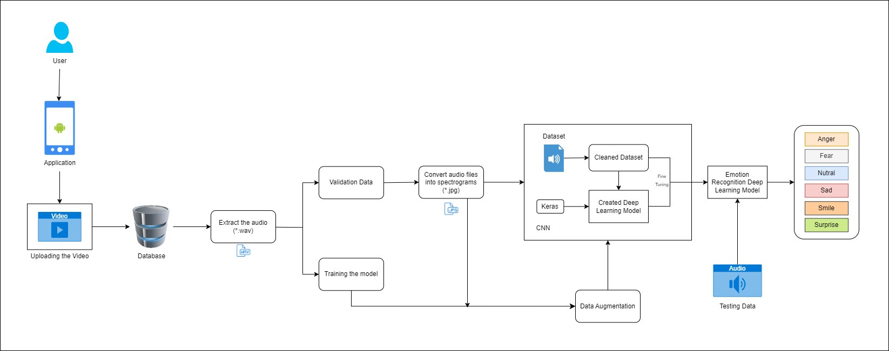
METHODOLOGY
SYSTEM DIAGRAM
IT20648268 | Damidu Thimesha | TMP-2023-24-133

Slide 34

METHODOLOGY
EVIDENCE OF COMPLETION
Data gathering
Data visualization
Data pre-processing (convert *.wav files into spectograms)
Training and testing validation
Created a from scratch deep learning model based on CNN to train the model
Host the finalized model in the flask server
Trained a large number of epochs to get a good accuracy
Display the final results in the mobile application
IT20648268 | Damidu Thimesha | TMP-2023-24-133

Slide 35
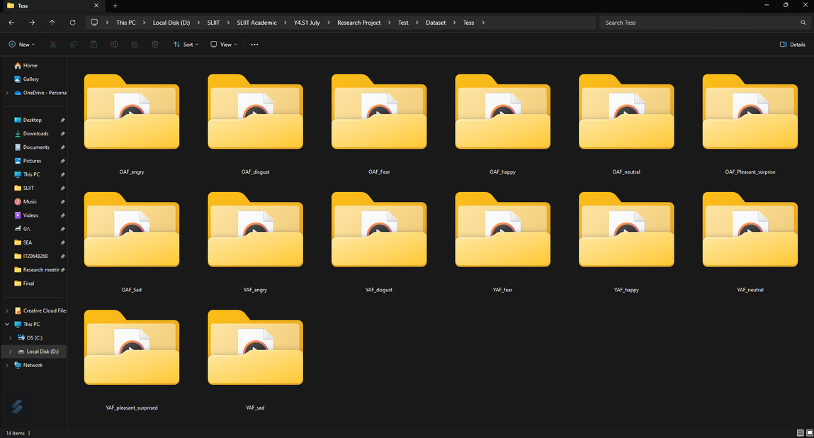
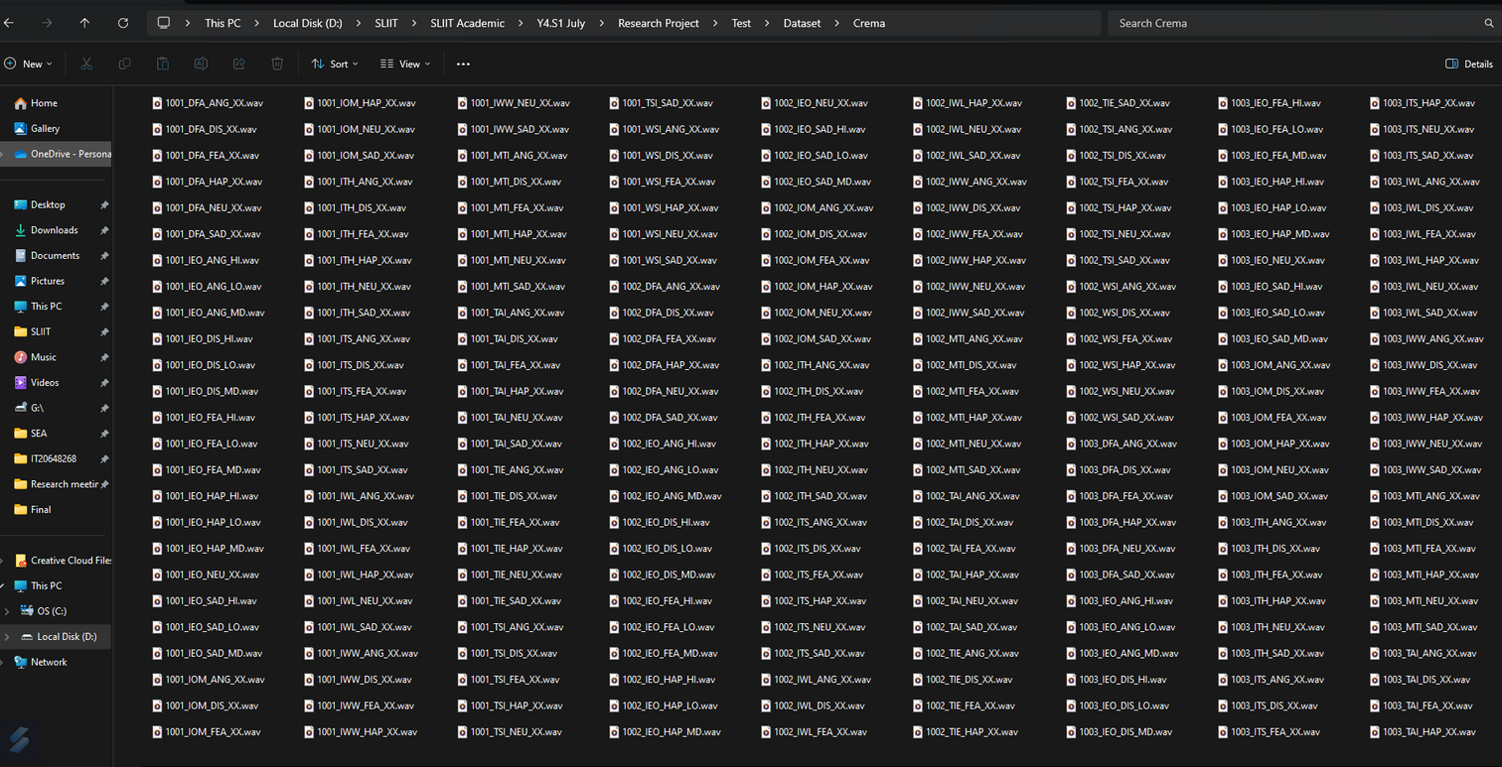
METHODOLOGY
Gathered Dataset - .wav files
DATASETS
IT20648268 | Damidu Thimesha | TMP-2023-24-133

Slide 36
METHODOLOGY
DATASETS
Finalized Dataset
All Images - 1440
Identification
Training
Validation
Recognition an emotion using audio data
1152
288
Data Preprocess
Normalization
Data augmentation
Convert audio files into spectrograms
IT20648268 | Damidu Thimesha | TMP-2023-24-133

Slide 37
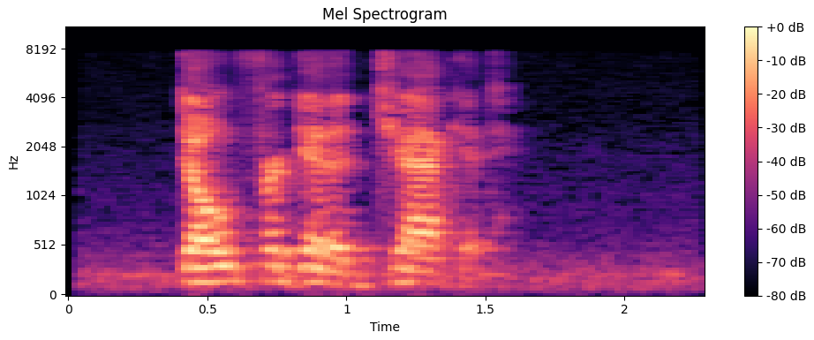
METHODOLOGY
DATASETS
Converted Spectrogram
IT20648268 | Damidu Thimesha | TMP-2023-24-133

Slide 38
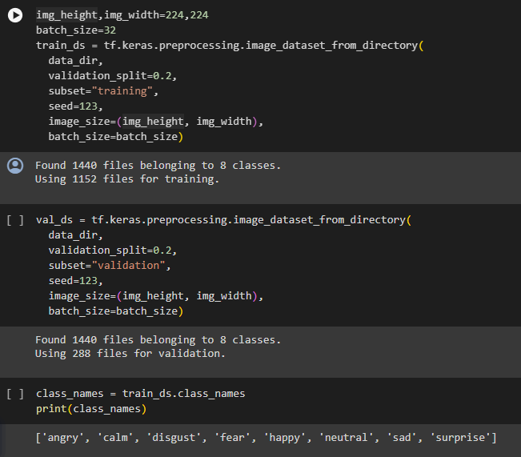
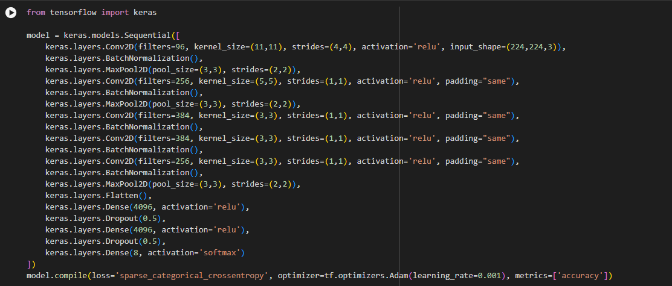
EVIDENCE OF COMPLETION
FROM SCRACH DEEP LEARNING ARCHITECTURES
IT20648268 | Damidu Thimesha | TMP-2023-24-133

Slide 39

EVIDENCE OF COMPLETION
TRANSFER LEARNING & FROM SCRACH DEEP LEARNING ARCHITECTURES
Emotion Identification accuracy
Test accuracies for CNN architectures
Architeccture
SVC (Support Vector Clasification)
ML Model
17.43%
Created Deep Learning Model
88.07%
IT20648268 | Damidu Thimesha | TMP-2023-24-133

Slide 40
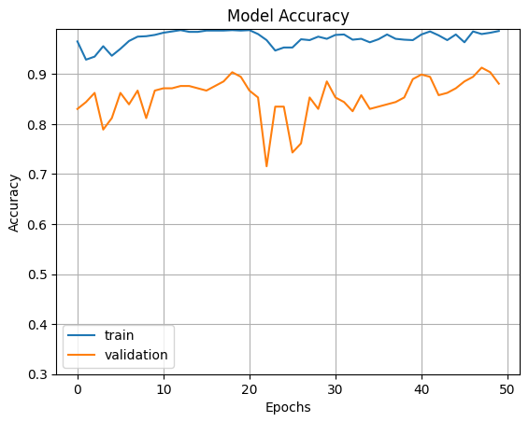
EVIDENCE OF COMPLETION
FROM SCRACH DEEP LEARNING ARCHITECTURES
IT20648268 | Damidu Thimesha | TMP-2023-24-133

Slide 41
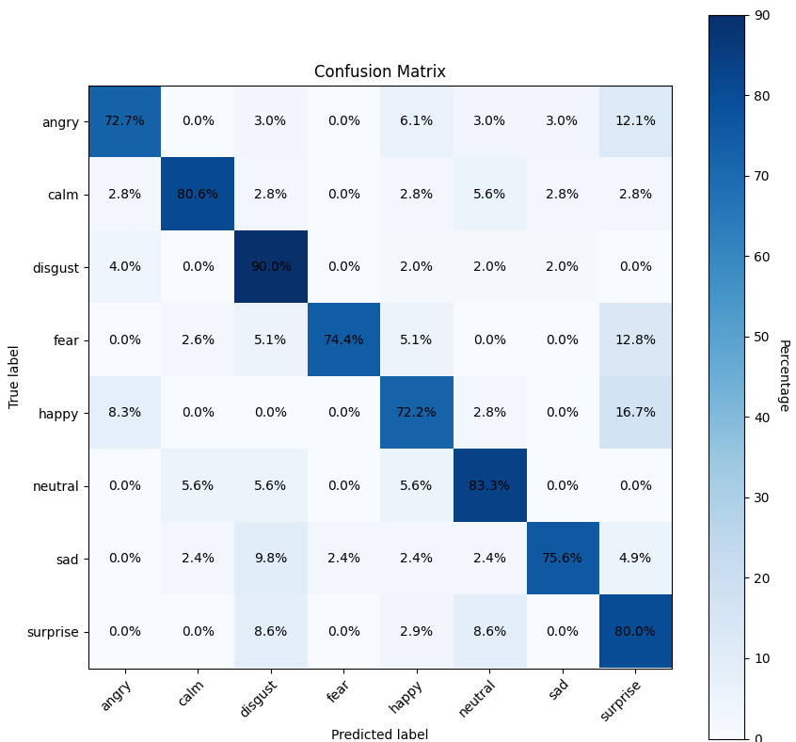
EVIDENCE OF COMPLETION
FROM SCRACH DEEP LEARNING ARCHITECTURES
Selected Deep Learning Architecture
Training data: 1152
Validation data: 288
IT20648268 | Damidu Thimesha | TMP-2023-24-133

Slide 42

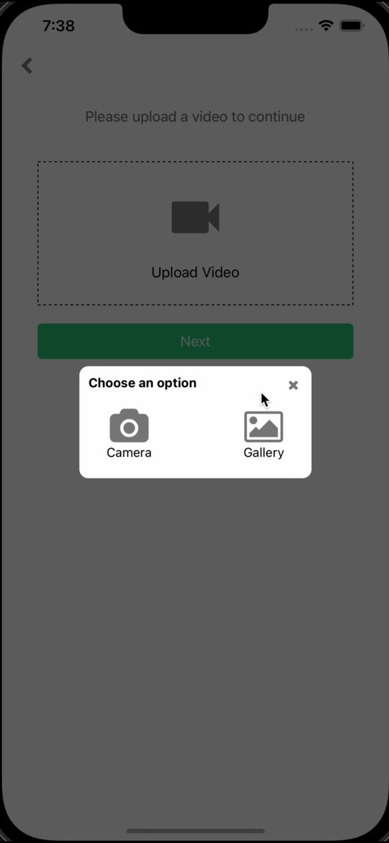
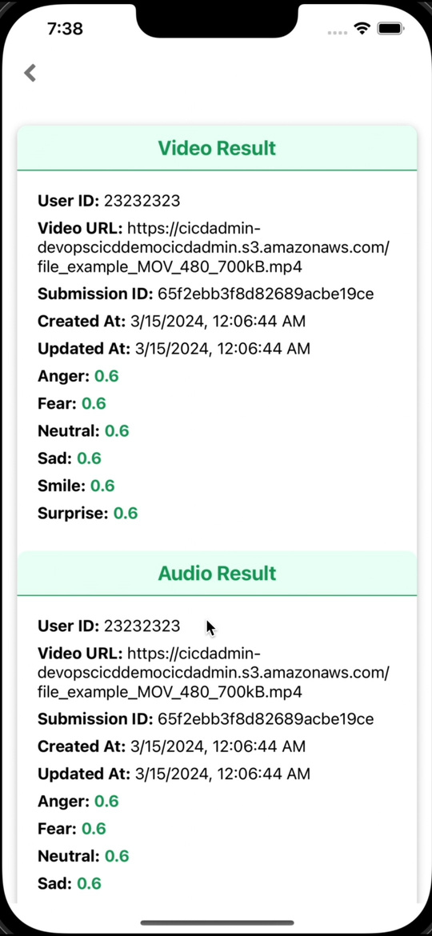
EVIDENCE OF COMPLETION
EMOTION IDENTIFICATION FROM AUDIO & VIDEO ANALYSIS DATA.
IT20648268 | Damidu Thimesha | TMP-2023-24-133

Slide 43
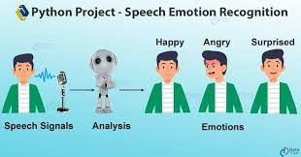
EVIDENCE OF COMPLETION
View summary of Previous Emotions
User can access their previous emotion summary and get an about idea.

Slide 44
EVIDENCE OF COMPLETION
SUMMARY OF SUB OBJECTIVE ACHIEVEMENT
Extract audio data from video call feed
Develop deep learning emotion recognition model.
Train that model using dataset
Goal Tracking and Emotional Growth Platform
IT20648268 | Damidu Thimesha | TMP-2023-24-133

Slide 45
SENTIMENT ANALYSIS
IMPLEMENTATION
IT20648886
SHAKILA
Dilshan
INFORMATION TECHNOLOGY

Slide 46
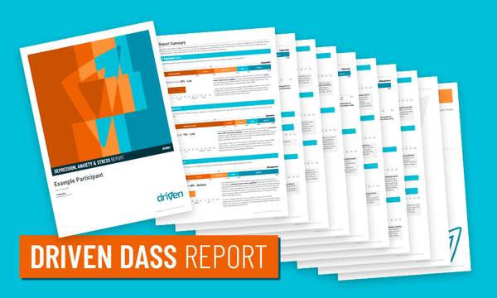

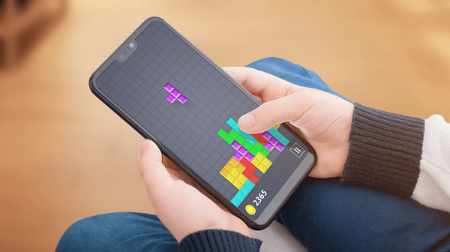
Introduction
Research Question
How to identify the Depression level of users using DASS-21 ?
How to provide them a calming games ?

Slide 47
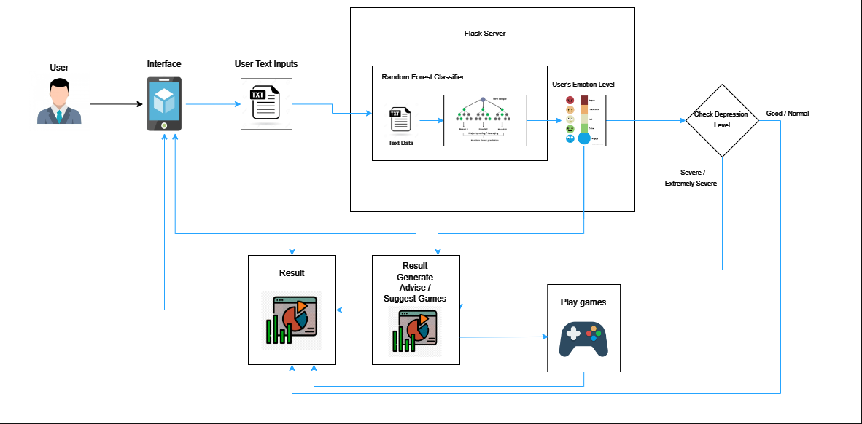
Methodology
System Diagram

Slide 48
Introduction
Specific & Sub Objectives
Collect DASS-21 questionnaire answers data using google form.
Identifying Depression levels & provide calming games
Develop Depression level identifying Model.
Create DASS-21 Questionair for gather user data.
Provide result & calming games

Slide 49
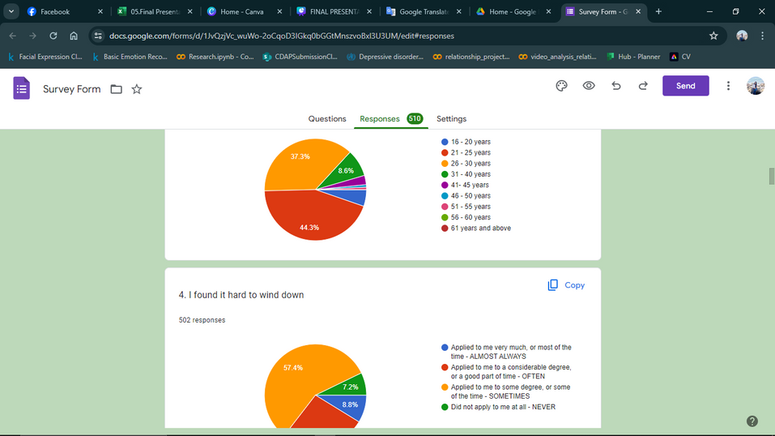
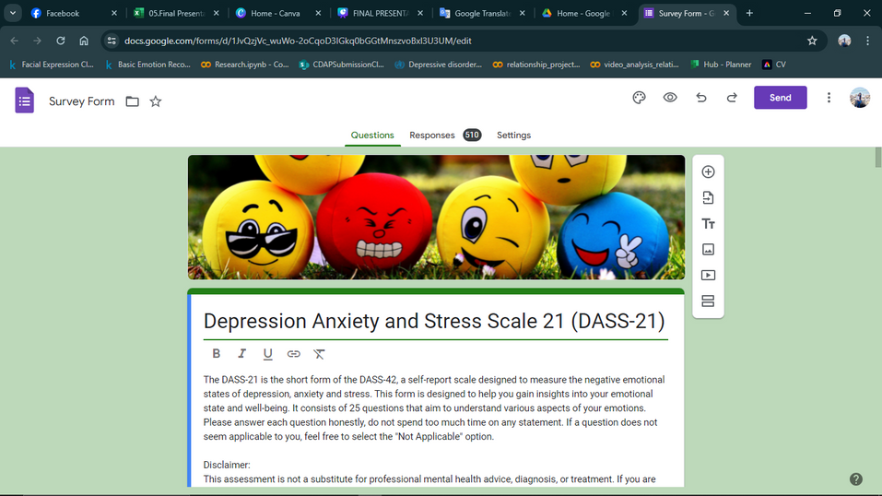
Collect DASS-21 questionnaire answers data using google form.
Sub Objective
Identification
Training
Testing
Data Preprocess
Data cleaning
Remove blank spots
Convert text data to numerical format(Encoding)
Recognition Depression levels using sentiment Analysis
371
93

Slide 50
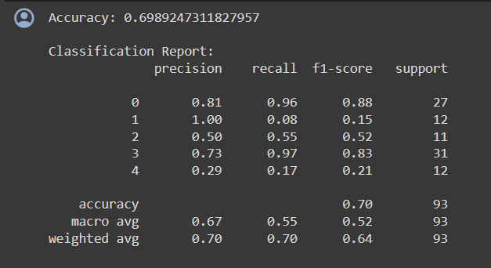

Sub Objective
Develop Depression level identifying Model.
Architeccture
Emotion Identification
Xgboost
69.89%
Randomeforest
68.81%
Test accuracies for Text classification architectures

Slide 51
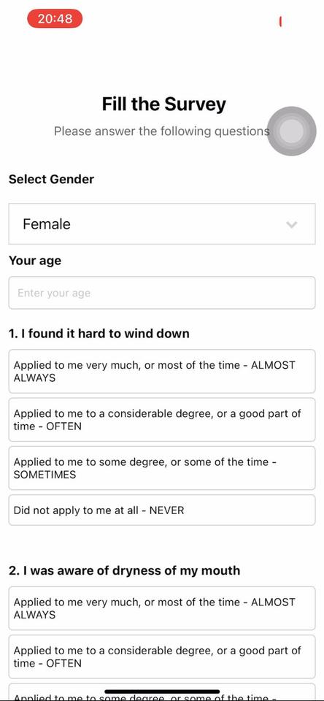
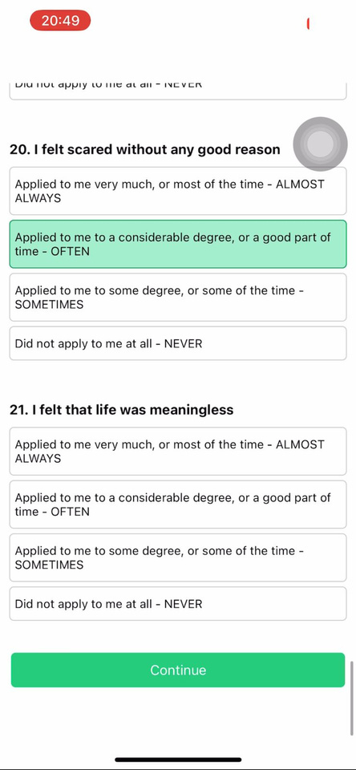
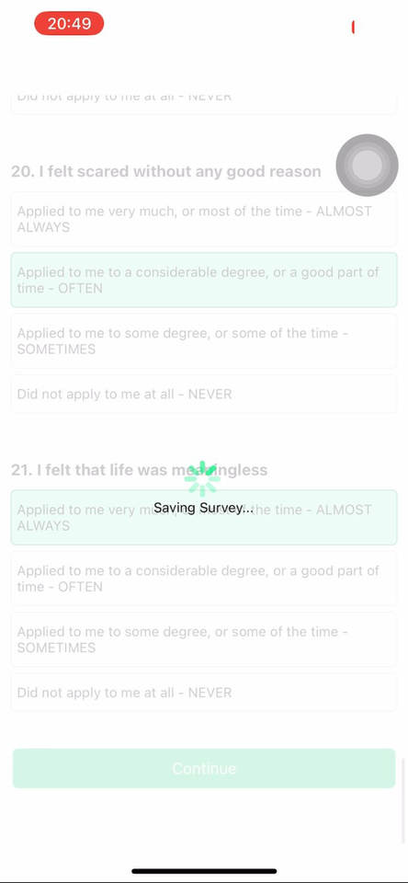
Sub Objective
Create DASS-21 Questionair for gather user data.

Slide 52
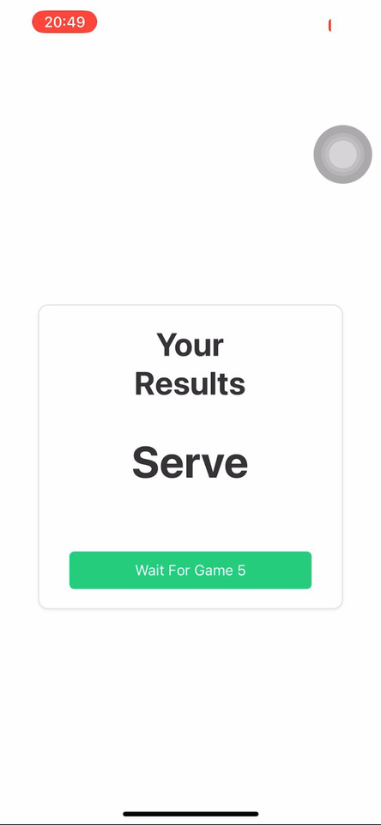
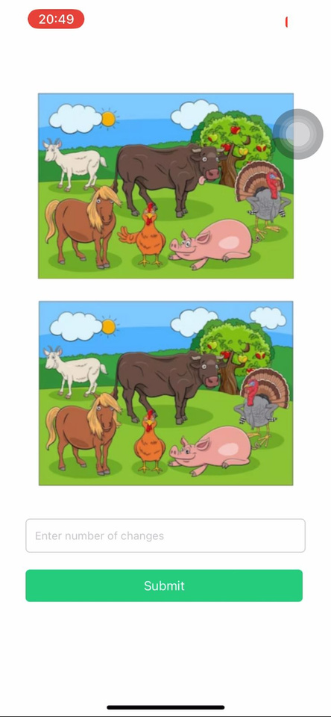
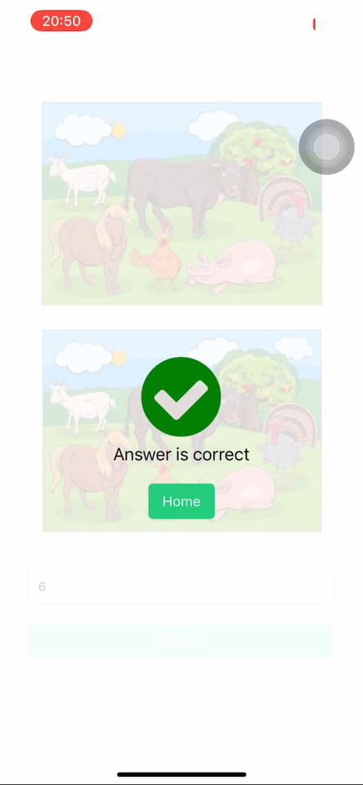
Sub Objective
Provide result & calming games

Slide 53
Summary of Sub Objective Achievement
100%
Collect DASS-21 Data & Make dataset
Develop Depression Level identifying model
Train the model using data
Provide a game for mind calming

Slide 54
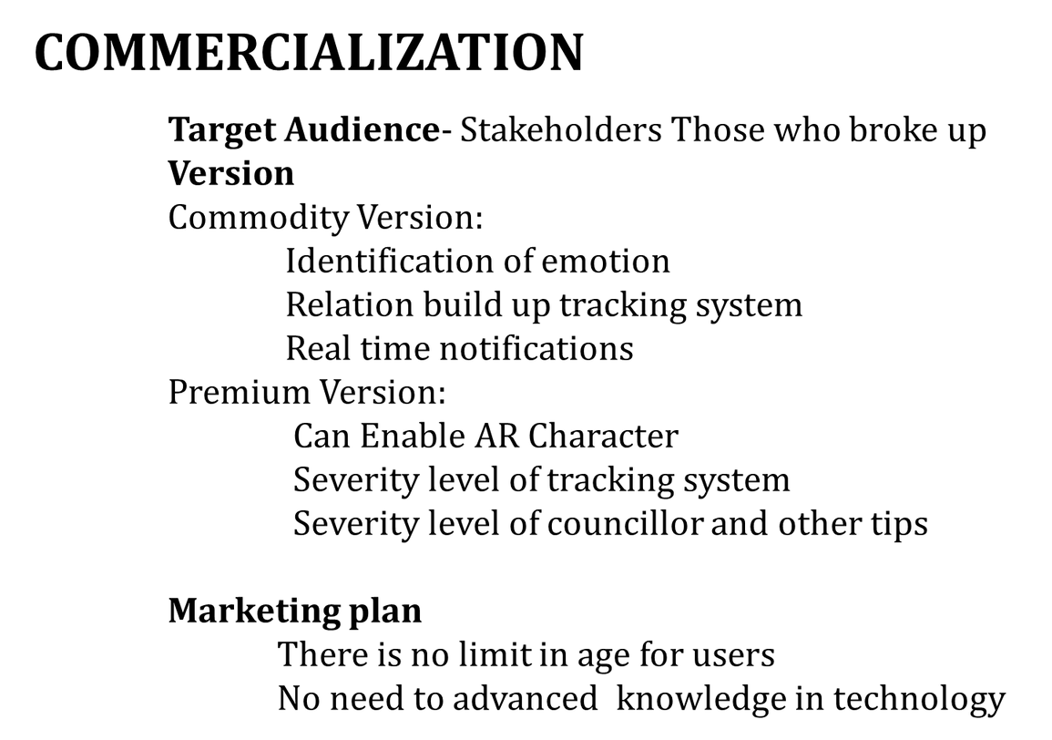
Commercialization Plan
Free Trial Version
Premium Version
Emotion detection and treatment recommendations.
Can enable VR character.
Unlimited emotion monitoring.
No Ads.
Rs 999/year
Basic functionality to monitor emotion.
Identification emotion level.
Trial period: 30 days (Free)
Contains Ads.
After the free trial period, users can choose to upgrade to the premium version or lose access to advanced features.

Slide 55
THANK YOU..!

